Slide 1
Unit 4
Statistical Analysis in Data Science

Slide 2
Descriptive Statistics
It measures the central tendency (mean, median, mode) and variability (range, variance, standard deviation).
Summarizes and understand data distribution and features.
Mean , median and mode are commonly used to measure the central tendency in statistics.
Variance is the measure of the spread or dispersion of data points.
Standard deviation is the square root of the variance, providing the measure of data variability.

Slide 3
Random Sampling and Sample Bias
Bias
Bias refers to a systematic error in the process of collecting, analyzing, interpreting or presenting data that leads to inaccurate results.
It skews the results in a particular direction and can mispresent the population under study.
Common types of Bias are:
Selection Bias: Occurs when the sample is not representative of the population.
Response Bias: Influenced by how survey questions are worded.
Measurement Bias: Due to errors in data measurement.

Slide 4
Population Vs Sample
Population Vs Sampling
A population is the entire set of the observations, while a sample is a subset taken from the population.
Sampling Distribution:
The distribution of a sample statistics (eg. Mean) across multiple random samples from the same population.
Sample from Population ( Simple Random Sampling, Cluster Sampling, Convenience Sampling, Stratified Sampling etc.)

Slide 5
Random Selection
Random sampling ensures every individual in the population has an equal chance of selection, reducing bias and improving representativeness.
Size Versus Quality
Larger sample sizes reduce random errors but don’t eliminate bias.
High-quality sampling strategies (e.g., stratified sampling) balance size and representativeness.

Slide 6
Example:
import random
# Simulating a random sample
population = list(range(1, 101)) # Population from 1 to 100
sample_size = 10
random_sample = random.sample(population, sample_size)
print("Random Sample:", random_sample)

Slide 7
Sample Mean vs. Population Mean
Sample Mean (μ): Calculated mean of a subset of the population.
Population Mean (μ): Mean of the entire population; generally unknown.
Mean vs. Median
Mean: Sum of values divided by the number of values.
Median: Middle value when data is ordered. Median is less affected by outliers.

Slide 8
Example
import numpy as np
data = [10, 12, 15, 20, 22, 23, 25, 30]
mean = np.mean(data)
median = np.median(data)
print(f"Mean: {mean}, Median: {median}")

Slide 9
1.2 Inferential Statistics
Central Limit Theorem
The sampling distribution of the sample mean approaches a normal distribution as the sample size increases, regardless of the population’s distribution.
Standard Error
Standard error measures the variability of the sample mean and is calculated as: Where:
s: Sample standard deviation
n: Sample size

Slide 10
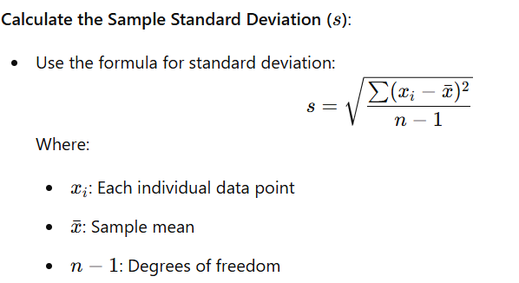
Sample Standard deviation (s)

Slide 11
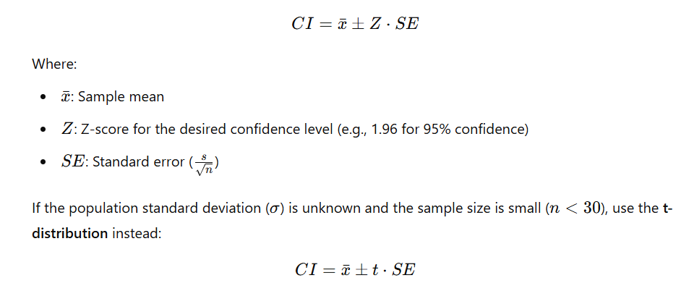
Confidence Intervals
A range of values likely to contain the population mean.
Formula for 95% CI:

Slide 12
Normal Distribution
The bell-shaped curve often used to model random variables in statistics.
Many machine learning algorithms assume that the data is normally distributed.

Slide 13
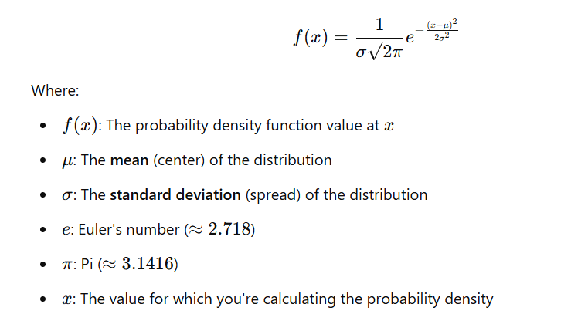

Slide 14
Student’s t-Distribution:
Used for small sample sizes or when population variance is unknown. Similar to the normal distribution but with heavier tails. Used for small sample size.
Bernoulli Distribution:
Model's binary outcomes (e.g. Success or failure)
Poisson Distribution:
Models the number of events occurring within a fixed interval of time or space.

Slide 15
Binomial Distribution:
Models the number of successes in a fixed number of trials with two possible outcomes.

Slide 16
Generate binomial distribution
x = np.arange(0, n+1)
y = binom.pmf(x, n, p)
# Plot the distribution
plt.bar(x, y, alpha=0.75, color='b', edgecolor='k')
plt.xlabel('Number of Successes')
plt.ylabel('Probability Mass Function')
plt.title(f'Binomial Distribution (n={n}, p={p})')
plt.grid(axis='y', linestyle='--', alpha=0.7)
plt.show()

Slide 17
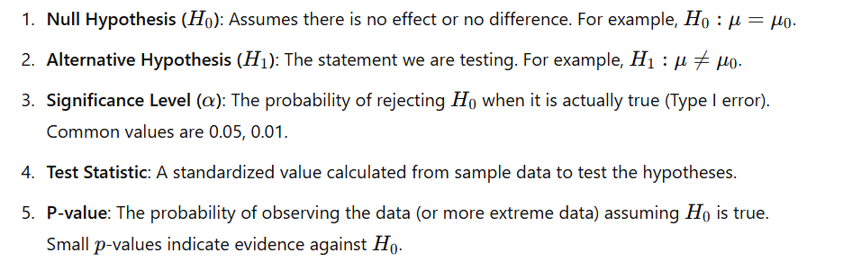
Hypothesis Test
Hypothesis testing is a statistical method used to decide whether there is enough evidence in a data sample to infer that a certain condition is true for the entire population.

Slide 18
Steps in Hypothesis Testing
State the null and alternative hypotheses.
Choose the significance level (α).
Compute the test statistic.
Calculate the p-value or compare the test statistic to critical values.
Make a decision:
If p-value ≤α: Reject H0
If p-value > α: Fail to reject H0.

Slide 19
Hypothesis Testing:
Null Hypothesis (H0):
A statement that there is no effect or no difference.
Alternative Hypothesis (H1):
A statement that there is an effect or difference.
p-Value: The probability of observing results as extreme as the ones obtained if the null hypothesis is true. It is used to determine statistical significance, where type I is a false positive and Type II is a false negative.

Slide 20
Type – I and Type-II Errors:
Errors made in hypothesis testing,
"Type I error" occurs when you reject a null hypothesis that is actually true (a false positive), while
"Type II error" happens when you fail to reject a null hypothesis that is actually false (a false negative).

Slide 21
Statistical Significance
Statistical significance measures whether the observed results of a study are likely to have occurred by chance or reflect a true effect.
It helps researchers determine the reliability of their findings.
Significance Level (α):
Commonly used values are 0.05 (5%) or 0.01 (1%).
It represents the threshold for rejecting the null hypothesis.

Slide 22
2. P-value:
If p-value ≤α : The result is statistically significant.
If p-value > α: The result is not statistically significant.
3.Confidence Interval (CI):
A range of values within which the true population parameter is likely to lie.
If the CI does not include the null hypothesis value, the result is statistically significant.

Slide 23
Example: One-Sample t-Test
Suppose a factory claims that the average weight of its products is 50g. A random sample of 10 products has the weights: [49.5, 50.1, 50.3, 49.9, 50.0, 49.7, 50.2, 49.8, 50.4, 49.6].
H0:μ=50
H1:μ≠50

Slide 24
One Sample and two sample t-test:
When we want to check if a sample mean is significantly different from a known or hypothesized population mean then we use one sample t-test.
A two-sample t-test is used to compare the means of two independent groups to determine if they are significantly different.

Slide 25
Example:
import numpy as np
from scipy.stats import ttest_1samp
# Sample data
data = [49.5, 50.3, 50.3, 50.9, 50.0, 49.4, 49.2, 49.8, 50.6, 49.8]
# Perform one-sample t-test
t_stat, p_value = ttest_1samp(data, 50)
# Significance level
alpha = 0.05
# Results
print("t-statistic:", t_stat)
print("p-value:", p_value)
if p_value < alpha:
print("Reject the null hypothesis. The mean is significantly different from 50.")
else:
print("Fail to reject the null hypothesis. No significant difference from 50.")

Slide 26
t-test
A common type of inferential standard test used to determine if there is a significant difference between the means of two groups.
It is particularly useful when dealing with small size (typically less than 30)or when the population standard deviation is unknown.
Types :
One sample t-test:
Used to compare the mean of a single sample to a known population mean or a hypothesized value.
2. Two sample t-test

Slide 27
Two Sample t-test
A two-sample t-test (also called independent samples t-test) is a parametric hypothesis test used to determine whether the means of two independent populations are statistically significantly different.
In Data Science, it is used to:
Compare model performance
Compare testing results
Compare before–after effects across different groups
Compare medical treatments

Slide 28
Types of Two-Sample t-Tests
Pooled (Equal Variance) t-Test
Used when:
Variances of both groups are equal
Welch’s t-Test (Unequal Variance)
Used when:
Variances are not equal
More common in real-world data science

Slide 29
Example: Two-Sample t-Test
Suppose we want to test if two groups of students have significantly different average scores:
Group A: [78, 85, 88, 92, 75, 80, 89]
Group B: [72, 70, 78, 74, 68, 77, 73]
Hypotheses:
H0:μA=μB (No difference in means)
H1:μA≠μB (Means are different)

Slide 30
Example:
from scipy.stats import ttest_ind
# Sample data
group_a = [80, 85, 87, 90, 75, 79, 79]
group_b = [74, 75, 78, 74, 68, 78, 73]
# Perform two-sample t-test with Welch's correction
t_stat, p_value = ttest_ind(group_a, group_b, equal_var=False)
# Significance level
alpha = 0.05
# Results
print("t-statistic:", t_stat)
print("p-value:", p_value)
if p_value < alpha:
print("Reject the null hypothesis. The means are significantly different.")
else:
print("Fail to reject the null hypothesis. No significant difference between means.")

Slide 31
Regression and Multivariate Analysis
Regression Analysis
Regression analysis is a statistical method used to model the relationship between a dependent variable and one or more independent variables. It helps in predicting values, understanding relationships, and making inferences.
Types of Regression
Simple Linear Regression (One independent variable)
Multiple Linear Regression (More than one independent variable)
Polynomial Regression (Non-linear relationship)
Logistic Regression (For classification problems)

Slide 32
Regression analysis is widely used for prediction, forecasting, modeling time series data and inferring the casual effect relationship between the variables.
Here, a graph that best fits the given data points is plotted.
This graph can either have a straight line or a curve that passes through all the data points on the graph that is drawn depicting the dependent and independent variables.
The vertical distance between the data points and the regression line should be minimum as this line indicates whether the model has captured a strong relationship or not.

Slide 33
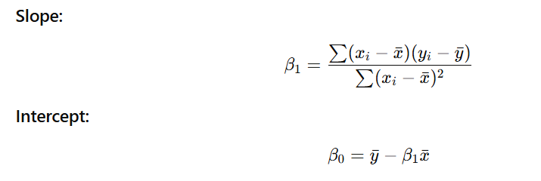
Simple Linear Regression
Linear regression is a simple yet powerful tool for modeling relationships between variables.
However, its assumptions must be carefully checked, and alternative methods like polynomial regression or non-linear models should be considered when the relationship is not linear.
The linear regression can be given as,
Y=b0+bx where,
b0 is the intercept
b is the coefficient of x

Slide 34
Linear Regression (from scratch)
import numpy as np
# Data
X = np.array([1,2,3,4,5])
Y = np.array([2,4,5,4,6])
# Mean
x_mean = np.mean(X)
y_mean = np.mean(Y)
# Slope
num = np.sum((X - x_mean) * (Y - y_mean))
den = np.sum((X - x_mean) ** 2)
b1 = num / den
# Intercept
b0 = y_mean - b1 * x_mean
print("Intercept:", b0)
print("Slope:", b1

Slide 35
Example using Scikit learn
from sklearn.linear_model import
LinearRegression
import numpy as np
X = np.array([1,2,3,4,5]).reshape(-1,1)
Y = np.array([2,4,5,4,6])
model = LinearRegression()
model.fit(X, Y)
print("Intercept:", model.intercept_)
print("Slope:", model.coef_[0])

Slide 36
Polynomial Regression
It is a form of linear regression in which the relationship between the independent variable x and dependent variable y is modeled as an nth degree polynomial.
This means that polynomial regression fits a non-linear relationship between the value of x and the corresponding conditional mean of y denoted by E (y/x).
It supports functionality that allows a wide range of function to fit under it.
It fits wide range of curvature.
The fitted model is more reliable.

Slide 37
Multivariate Analysis
Multivariate analysis is used when there are multiple independent and dependent variables. It includes:
Multiple Linear Regression (Predicting one dependent variable using multiple independent variables)
Principal Component Analysis (PCA) (Dimensionality reduction)
Factor Analysis (Identifying hidden factors)
Cluster Analysis (Grouping similar data points)

Slide 38
Multiple Linear Regression
Mathematical equation:
Y=β0+β1X1+β2X2+...+βnXn+ϵ

Slide 39
Example:
import pandas as pd
from sklearn.model_selection import train_test_split
from sklearn.metrics import mean_squared_error
# Sample Data
data = {'X1': [1, 2, 3, 4, 5], 'X2': [2, 4, 6, 8, 10], 'Y': [3, 6, 9, 12, 15]}
df = pd.DataFrame(data)
# Independent & Dependent Variables
X = df[['X1', 'X2']]
Y = df['Y']
# Train-Test Split
X_train, X_test, Y_train, Y_test = train_test_split(X, Y, test_size=0.2, random_state=42)
# Model Training
model = LinearRegression()
model.fit(X_train, Y_train)
# Predictions
predictions = model.predict(X_test)
# Evaluation
mse = mean_squared_error(Y_test, predictions)
print(f"Mean Squared Error: {mse}")

Slide 40
Example:
import pandas as pd
from sklearn.model_selection import train_test_split
from sklearn.metrics import mean_squared_error
# Sample Data
data = {'X1': [1, 2, 3, 4, 5], 'X2': [2, 4, 6, 8, 10], 'Y': [3, 6, 9, 12, 15]}
df = pd.DataFrame(data)
# Independent & Dependent Variables
X = df[['X1', 'X2']]
Y = df['Y']
# Train-Test Split
X_train, X_test, Y_train, Y_test = train_test_split(X, Y, test_size=0.2, random_state=42)
# Model Training
model = LinearRegression()
model.fit(X_train, Y_train)
# Predictions
predictions = model.predict(X_test)
# Evaluation
mse = mean_squared_error(Y_test, predictions)
print(f"Mean Squared Error: {mse}")

Slide 41
Time Series Analysis
Time series analysis involves analyzing data points collected over time to detect patterns, trends, and seasonal effects.
Components of Time Series
Trend (T): Long-term movement in the data
Seasonality (S): Regular, periodic fluctuations
Cyclic (C): Irregular, long-term fluctuations
Random (R): Unpredictable variations

Slide 42
Time Series Forecasting Models
Moving Average (MA)
Exponential Smoothing (ES)
ARIMA (Auto Regressive Integrated Moving Average)
LSTM (Deep Learning Model)

Slide 43
Conditional Probability & Bayes' Theorem
Conditional probability is the probability of an event occurring given that another event has already occurred. It is denoted as:
P(A∣B)=P(A∩B)/ P(B)where:
P(A∣B) is the probability of event A occurring given that event B has occurred.
P(A∩B) is the probability of both A and B occurring.
P(B) is the probability of B.

Slide 44
Bayes' Theorem
Bayes' theorem allows us to update our beliefs based on new evidence. It is given by:
P(A∣B)=P(B∣A)P(A)/P(B) , ​where:
P(A∣B) is the probability of A given B.
P(B∣A) is the probability of B given A.
P(A) and P(B) are the probabilities of A and B independently.

Slide 45
# Example of Bayes' Theorem
P_A = 0.02 # Probability of disease
P_B_given_A = 0.9 # Test positive given disease
P_B_given_not_A = 0.05 # Test positive without disease
P_not_A = 1 - P_A #probabiklity of not having disease
P_B = P_B_given_A * P_A + P_B_given_not_A * P_not_A
P_A_given_B = (P_B_given_A * P_A) / P_B
print(f"P(A|B): {P_A_given_B}")

Slide 46
End of the Chapter

